Slide 2
Energy at Sea
Delimitation and state jurisdiction
Security of energy installations
Respect of marine environment
Energy investments and trade
Energy law + Resources law

Slide 3
International Court of Justice
Delimitation of maritime boundaries
Environmental legal implications

Slide 4
PART I: Energy at Sea as a factor for determining maritime boundaries
Problems relating to the exploitation of energy resources are of recent origin
First time that energy at sea is mentioned in an ICJ case is in the North Sea Continental Shelf case:
“there is no legal limit to the factors that may constitute a special circumstance that the Court should take into account when applying equitable procedures” (North Sea Continental Shelf, par. 97)

Slide 5
Energy resources as “special circumstances” (1)
Economic factors: key political role but there is no rule that requires States to delimit their respective sections of the continental shelf in such a way as to apportion to each surrounding State a “fair share” of the resources.
Tunisia/Libya
Gulf of Maine
Greenland/Jan Mayen

Slide 6
Energy resources as “special circumstances” (2)
“the presence of oilwells in an area to be delimited, it may, depending on the facts, be an element to be taken into account” (Tunisia/Libya, par.107)
“it would be neither just nor equitable to base a delimitation on the evaluation of data which changes in relation to factors that are sometimes uncertain” (Guinea/Guinea Bissau arbitration)

Slide 7
The conduct of the States
Oil concessions and oil wells may only be taken into account as special circumstances are justifying the adjustment or shifting of the provisional delimitation line if they are based on express or tacit agreement between the parties.
Cameroon/Nigeria
Nicaragua/Honduras
Guyana/Suriname

Slide 8
PART II: Environmental legal implications from energy activities at sea
Environmental concerns
Delimitation & Installation
Special Protected Areas
Production & Transport
Environmental harm
International Law Association – Regional Conference 2014
Notes:
8

Slide 9
ICJ’s contribution
Core notion: sustainable development
a “need to reconcile economic development with protection of the environment is aptly expressed in the concept of sustainable development” (Gabcikovo-Nagymaros Project)
Industrial activities: obligation of prior conduct of an EIA (Pulp Mills)
Energy
development
Protection of the environment
International Law Association – Regional Conference 2014

Slide 10
Missed opportunities (1)
Reluctance of international courts and tribunals to proceed to a principle of allocation of energy resources
A step ahead
green light for energy resource exploration and exploitation in disputed waters
International Law Association – Regional Conference 2014
10

Slide 11
Missed opportunities (2)
No ruling on state liability from transboundary environmental harm (see old fashioned Corfu Channel Case).
No dicta on the nature of the precautionary principle (Gabcikovo-Nagymaros, Pulp Mills, Whaling, Aerial Herbicide Spraying). See, nevertheless, dissenting/separate opinions of Judge Weeramantry in Nuclear Tests (1995), Legality of Use of Nuclear Weapons, Gabcikovo-Nagymaros.
International Law Association – Regional Conference 2014

Slide 12
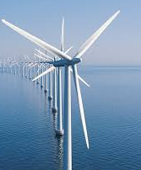
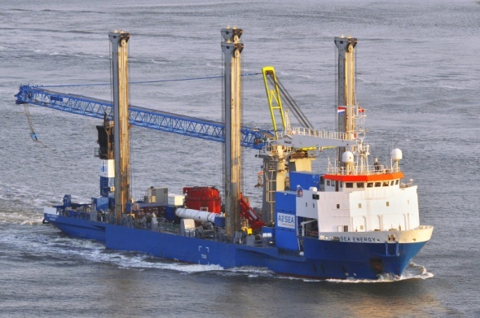
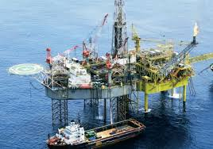
THANK YOU FOR YOUR ATTENTION!!!!
This paper was prepared under the Research Project “Energy at Sea” under the Research Funding Program ARISTEIA II, funded by the Greek Secretariat for Research and Technology.

