Slide 1
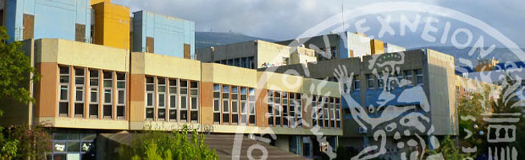
Innovative research in exploring for energy resources: the role of modern Biotechnology
Professor Fragiskos Kolisis,
School of Chemical Engineering,
The National Technical University of Athens

Slide 2
Definition:
biotechnology is the use of biological processes, organisms, or systems to manufacture products intended to improve the quality of human life.
The earliest biotechnologists were farmers who developed improved species of plants and animals by cross breeding.
Some biotechnological products through the ages include bread, wine, beer, etc, in general applications such as fermentation and brewing, have been used for millennia.
In recent years, biotechnology has expanded in sophistication, scope, and applicability.

Slide 3
Various definitions of Biotechnology
European Federation of Biotechnology [Biotechnology is] “the integrated use of biochemistry, microbiology, and engineering sciences in order to achieve technological (industrial) application of the capabilities of micro-organisms, cultured tissue cells, and parts thereof”
Federal Republic of Germany “Biotechnology deals with the introduction of biological methods within the framework of technical processes and industrial production. It involves the application of microbiology and biochemistry together with technical chemistry and process engineering” .
France “Biotechnology consists of the industrial exploitation of the potential of micro-organisms, animal and plant cells, and subcellular fractions derived from them”
International Unions of Pure and Applied Chemistry [Biotechnology is] “the application of biochemistry, biology, microbiology, and chemical engineering to industrial processes and products (including here the products in health care, energy, and agriculture) and on the environment”
Japan IBiotechnology is] “a technology using biological phenomena for copying and manufacturing various kinds of useful substances”
The Netherlands [Biotechnology is) “the science of the production processes based on the action of microorganisms and their active components, and of production processes involving the use of cells and tissues from higher organisms. Medical technology, agriculture, and traditional crop breeding are not generally regarded as biotechnology”
Organisation for Economic Co-Operation and Development Biotechnology consists of “the application of scientific and engineering principles to the processing of materials by biological agents to provide goods and services”

Slide 4
The science of biotechnology can be broken down into subdisciplines called red, white, green, and blue.
Red biotechnology involves medical processes such as getting organisms to produce new drugs, or using stem cells to regenerate damaged human tissues and perhaps re-grow entire organs.
White (also called gray) biotechnology involves industrial processes such as the production of new chemicals or the development of new fuels for vehicles.
Green biotechnology applies to agriculture and involves such processes as the development of pest-resistant grains or the accelerated evolution of disease-resistant animals.
Blue biotechnology, rarely mentioned, encompasses processes in marine and aquatic environments, such as controlling the proliferation of noxious water-borne organisms.

Slide 5
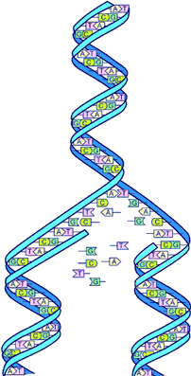
Human Genome Project
The Human Genome Project (HGP) is an international scientific research project with the goal of determining the sequence of chemical base pairs which make up human DNA, and of identifying and mapping all of the genes of the human genome.[
It remains the world's largest collaborative biological project. The project was proposed and funded by the US government; planning started in 1984, the project got underway in 1990, and was declared complete in 2003. A parallel project was conducted outside of government by the Celera Corporation, or Celera Genomics, which was formally launched in 1998. Most of the government-sponsored sequencing was performed in twenty universities and research centers in the United States, the United Kingdom, Japan, France, Germany, and China.
The Human Genome Project originally aimed to map the nucleotides contained in a human haploid reference genome (more than three billion). The "genome" of any given individual is unique; mapping "the human genome" involves sequencing multiple variations of each gene.
There are approximately 20,500^{[29]} genes in human beings, the same range as in mice. The project did not study the entire DNA found in human cells; some heterochromatic areas (about 10% of the total genome) remain unsequenced.

Slide 6
New paradigm in Biology
From the dogma: one gene one phenotype
To System biology
.
SYSTEMS BIOLOGY
. Kitano -2002-a Science 295,1662-1664, b Nature 420,206-210
The study of living organisms in terms of their underlying network structure rather than simply their individual molecular components. A "system" can be anything from a gene regulatory network to a cell, a tissue, or an entire organism. Computational approaches are required to handle and interpret the data necessary to understand complex biological systems.

Slide 7

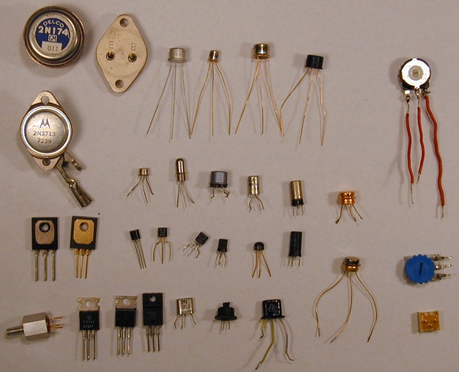
The Combinatorial Advantage
Not only the parts are important, but also the way they are connected

Slide 8







Systems Biology
Not only the parts are important, but also the way they are connected

Slide 9
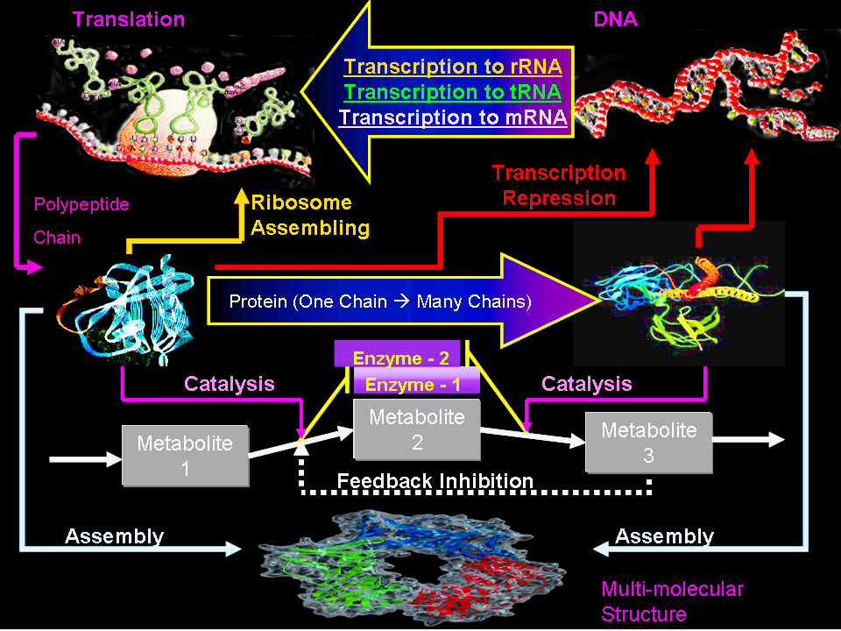

Slide 10
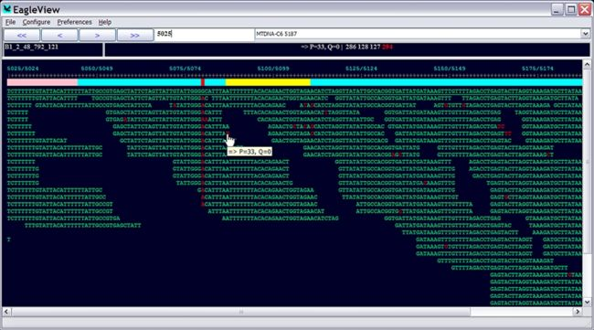
DNA sequencing
Sanger sequencing: Μέθοδος αλληλούχισης DNA με τερματισμό αλυσίδας
Εύρεση αλυσίδας DNA (Μέθοδος OLC):

Slide 11
BIOTECHNOLOGY AND RISK ASSESMENT
Biotechnology, like other advanced technologies, has the potential for misuse. Concern about this has led to efforts by some groups to enact legislation restricting or banning certain processes or programs, such as human cloning and embryonic stem-cell research, GMOs, etc.
There is a rich public debate about how the potential risks associated with biotechnology methods and bioindustry products should be assessed and about whether and how bioethics should influence public policy. A general structure for guiding public policy discourse is emerging but is not fully developed. Groups perceive risks differently depending on their culture, scientific background, perception of government, and other factors. Expert opinion supports a range of positions

Slide 12
Innovative research in exploring for energy resources: the role of modern Biotechnology
Three examples
Antifouling to protect ships
Biodiesel from green algae
Oil and Gas Exploration Based on Metagenomic Analysis

Slide 13
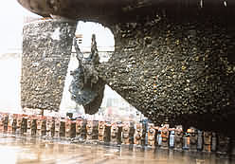
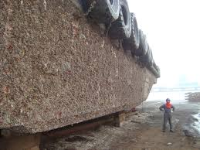
Biofouling or biological fouling is the accumulation of microorganisms, plants,algae, or animals on wetted surfaces.
The buildup of biofouling on marine vessels poses a significant problem. Over time, the accumulation of biofoulers on hulls can increase both the hydrodynamic volume of a vessel and the frictional effects leading to increased drag of up to 60%^{[4]} The drag increase has been seen to decrease speeds by up to 10%, which can require up to a 40% increase in fuel to compensate. With fuel typically comprising up to half of marine transport costs, antifouling methods are estimated to save the shipping industry around $60 billion per year. Increased fuel use due to biofouling contributes to adverse environmental effects and is predicted to increase emissions of carbon dioxide and sulfur dioxide between 38 and 72% by 2020.^{[5]}

Slide 14
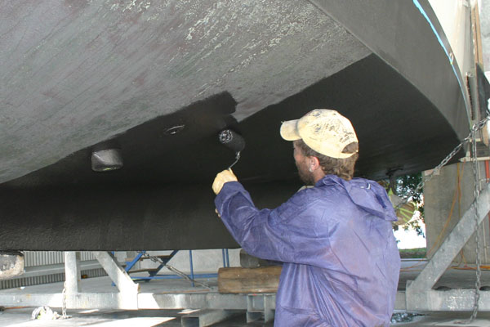
A
After having analyzed the serious environmental problems caused by an indiscriminate use of highly toxic biocides coming from organic derivatives of tin compounds and the uncontrolled emissions of volatile organic compounds (VOC) to the atmosphere, the evolving technology of antifouling paintings (further mandated by current environmental standards) aims to develop environmentally innocuous water-based coverings in which extracts of the very same marine world are used as biocide compounds.
Water-based coatings are being developed that use low-toxic elements and natural biocides, where bacteria is isolated from surfaces immersed in the marine environment, creating a promising source of natural antifouling compounds.
The result is a new environmentally friendly antifouling coating that is able to mitigate the problem of biofouling without affecting the surrounding medium, and which may be applied on any artificial structure in contact with seawater

Slide 15
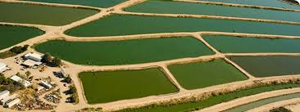
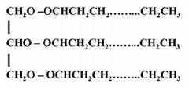
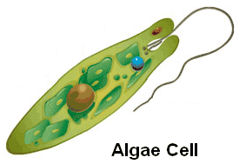
BIODIESEL from green algae
The present economic dependency of our society on fossil fuels and the resulting effects on climate and environment have put tremendous pressure towards the utilization of renewable biomass sources including microalgae species. Algae (i.e., macro and microalgae,) are excellent examples of feedstock biomass with a large potential for flexible production of biofuels and bio-based building blocks. Among algal fuels' attractive characteristics are that they can be grown with minimal impact on Fresh water resources, can be produced using saline and waste water. Because the cells grow in aqueous suspension, where they have more efficient access to water, CO
2 and dissolved nutrients, microalgae are capable of producing large amounts of biomass and usable oil in either high rate algal ponds or Photobioreactors. This oil can then be turned into BIODIESEL by esterification, which could be sold for use in automobile

Slide 16
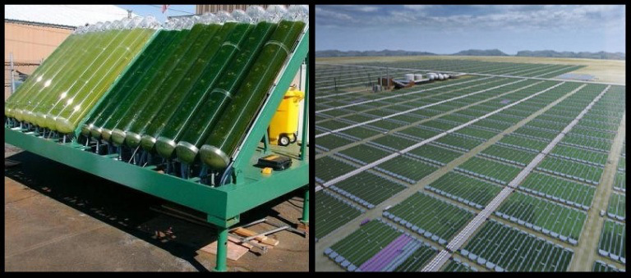
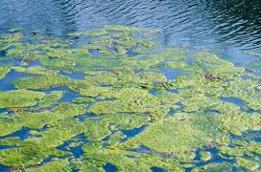
BIODIESEL IN THE MARKET
Blends of biodiesel and conventional hydrocarbon-based diesel are products most commonly distributed for use in the retail diesel fuel marketplace. Much of the world uses a system known as the "B" factor to state the amount of biodiesel in any fuel mix:[
100% biodiesel is referred to as B100
20% biodiesel, 80% petrodiesel is labeled B20^{[1]}
5% biodiesel, 95% petrodiesel is labeled B5
2% biodiesel, 98% petrodiesel is labeled B2

Slide 17
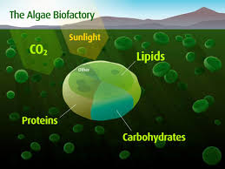
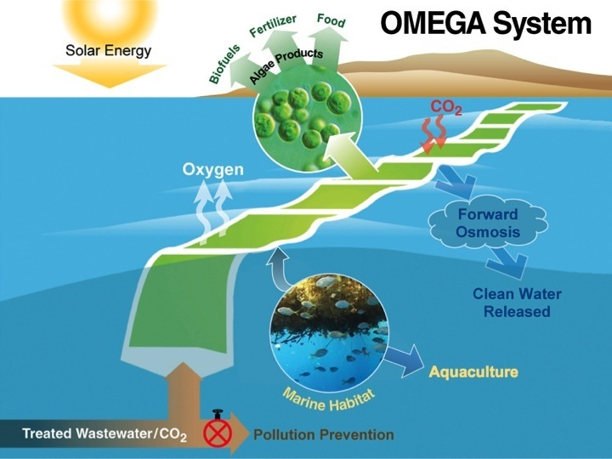
BIOREFINERY (our project)
To gain full benefit of microalgal biomass, we investigate the combined production of biofuels and high-added value, low-volume chemicals (r3-carotene, astaxanthin, xanthophyll, polyunsaturated fatty acids, vitamins, polysaccharides, nutraceuticals, etc.) in an integrated way by considering all important aspects involved in the microalgal biomass processing.

Slide 18
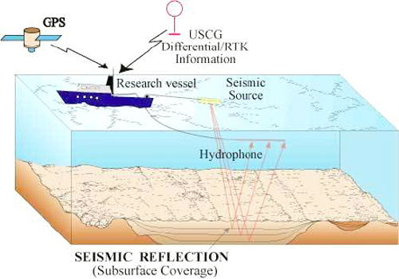
Oil and Gas Exploration Based on Metagenomic Analysis
Oil seeps, natural gas seeps, pockmarks (underwater craters caused by escaping gas) provide basic evidence of hydrocarbon generation.
Most exploration depends on highly sophisticated technology to detect and determine the extent of these deposits using exploration geophysics.(gravity and magnetic survey, passive seismic, or regional seismic reflection surveys).
Oil exploration is an expensive, high-risk operation. Offshore and remote area exploration is generally only undertaken by very large corporations or national governments.
Typical Oil Wells (e.g. North Sea) cost US$10 – 30 million, while deep water wells can cost up to US$100 million plus.

Slide 19
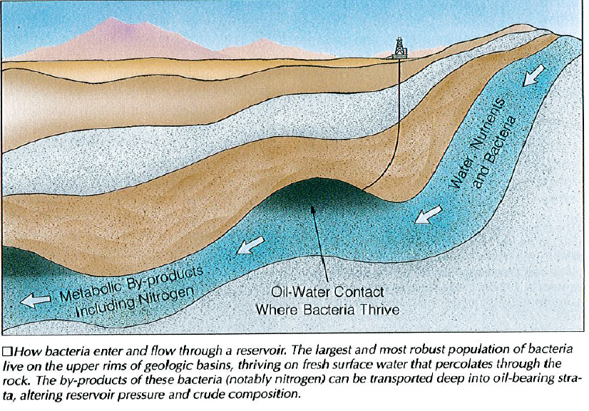
Metagenome research uses random shotgun sequencing of microbial community DNA to study the genetic profile of its members avoiding thus the occasionally problematic previous cultivation step. It is also known that one of the essential steps in metagenome analysis is the reconstruction of draft genomes for populations of a community.
Marine prokaryotes are involved in a series of geological processes including hydrocarbon degradation and fixation of CO₂. These processes are fairly well understood. However, in order to take advantage of these properties in oil and gas exploitation there is a need for a metagenomic approach for understanding of the entire pathways and the interaction with the environment in order to develop efficient methods for monitoring these processes. The goal of the proposed project is to develop efficient methods for more environmental friendly oil exploration.
.

Slide 20
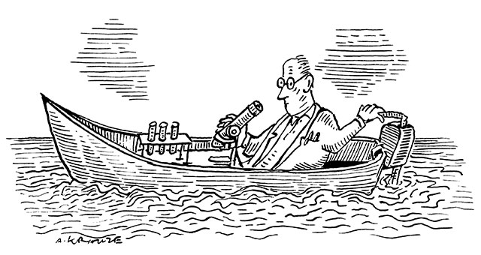
.
.
The idea in this project is to develop the monitoring techniques further for oil and gas exploration with more environmental friendly approaches.
This should allow more efficient searches for new oil and gas reservoirs (allowing for screening of hitherto unexploited or uninvestigated areas, and more precise use of test drilling and seismic investigations).
The approaches taken will methodologically be quite similar to the CO₂ storage approach from a metagenomic perspective,
Biological hydrocarbon monitoring: Prokaryotic communities are capable of utilizing hydrocarbons as primary carbon source in their metabolism. Our previous investigations have shown that this leaves a microbial footprint highly distinguishable from the neighbouring communities around a hydrocarbon seep. We have characterized genes associated with such processes using metagenomics (Håvelsrud et al. 2011, 2012). It should therefore be feasible to develop simple and efficient monitoring techniques for the detection of microbial hydrocarbon utilization

