Slide 1
Energy at Sea:
Rights of local populations?
Alexandra Xanthaki
Brunel Law School
United Kingdom

Slide 2
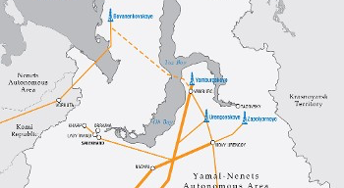
92% of Russian energy projects comes from the areas of Yamal Nenets

Slide 3
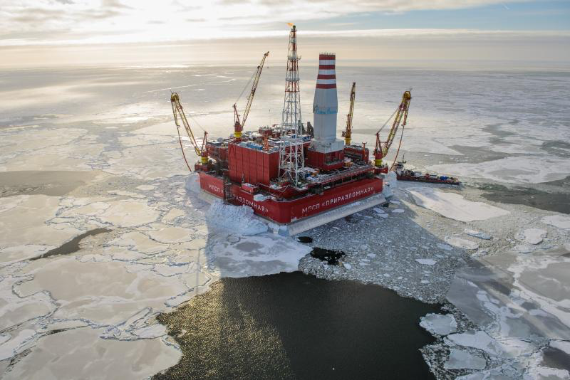
92% of Russian energy projects comes from the areas of Yamal Nenets

Slide 4
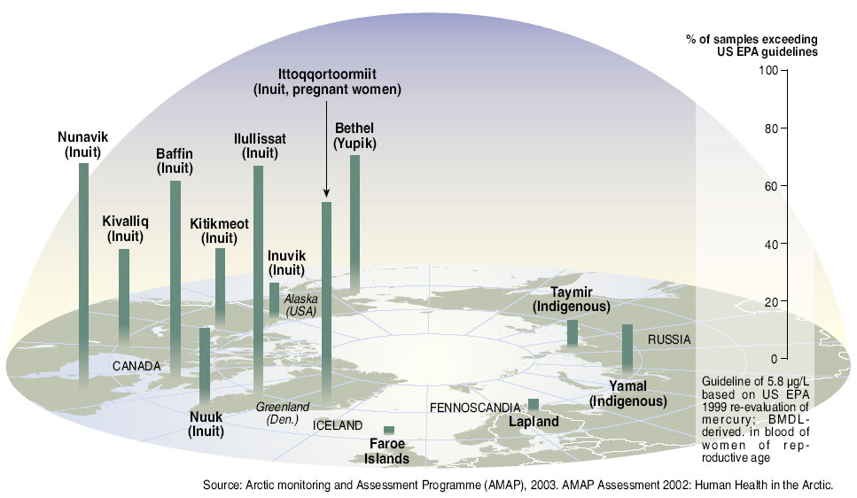
Case study: Mercury levels in the blood of indigenous women of reproductive age in the Arctic

Slide 5
Human Rights
Part of the generally accepted standards included in the UNCLOS?
In 2013, the UN Permanent Forum on Indigenous Issues¹ concluded that treaties, including the UNCLOS, should be re-visited and reformed to take account of Indigenous rights.
Human rights and law of the sea part of a whole

Slide 6
Consultation and participation rights
Article 27 ICCPR: ‘right not to be denied’ their rights to participation
Interpeted by UN Decl on Minorities: effective participation
Art. 5 ILO 107: collaboration of indigenous peoples and their representatives
Principle 22 of Rio Declaration: effective participation
World Bank Operational Directive 4.10: free, prior and effective consultation
UN SRII: right to consultation is customary international law

Slide 7
Free, Prior and Informed consent
Free, Prior and Informed consent
In 7 articles of the UNDRIP
Article 32 (2) UNDRIP: right to be consulted ‘in order to obtain their free and informed consent prior to the approval of any project affecting their lands or territories and other resources, particularly in connection with the development, utilization or exploitation of mineral, water or other resources.’

Slide 8
Case law
HRC 2009 Angela Poma Poma v. Peru: involved the impact on water beneath indigenous peoples’ lands, that “participation in decision-making process must be effective, which requires not mere consultation but the free, prior and informed consent of the members of the community.
Inter-AmerCtHR (2007) Saramaka People v Suriname: large scale development or investment project that would have an impact on indigenous communities.
the State “has the duty, not only to consult with the [indigenous group], but to obtain their free, prior and informed consent, according to their customs and traditions.”

Slide 9
Case law 2
African ComHR (2012) Endorois case:
The state ‘has a duty not only to consult with the community, but also to obtain their free, prior, and informed consent, according to their customs and traditions [in relation to] any development or investment projects that would have a major impact within [their] territory.

Slide 10
Does FPIC mean veto?
UN SRIP: a “direct impact on indigenous peoples’ lives or territories establishes a strong presumption that the proposed measure should not go forward without indigenous peoples’ consent”, and that “in certain contexts, that presumption may harden into a prohibition of the measure or project in the absence of indigenous consent.”

Slide 11
Land rights
ownership? No
But:
  No relocation
  Recognition of deep spiritual relationship
  HR Impact Assessments
  European Commission, OECD, FAO
  Redress
  Benefit Sharing
Cultural and Social Rights
  Underwater heritage
  Related traditional activities
  Not only for ‘high value’ culture

Slide 12
Conservation in energy at sea
Article 24 UNDRIP
Indigenous peoples have the right to (…) the conservation of their vital medicinal plants, animals and minerals.
Article 32 UNDRIP
1. Indigenous peoples have the right to determine and develop priorities and strategies for the development or use of their lands or territories and other resources.
2. States shall consult and cooperate in good faith with the indigenous
peoples concerned through their own representative institutions in order to obtain their free and informed consent prior to the approval of any project affecting their lands or territories and other resources, particularly in connection with the development, utilization or exploitation of mineral, water or other resources.

Slide 13
Legal force of the norms
UNDRIP soft law
Recent study: of 52 large US-based extractive companies, only one had an explicit policy of respecting indigenous FPIC, while only four had company-wide indigenous policies but
State has the main responsibility
UNDRIP translates other legally binding rules
Special legitimization
More and more used in the national level
FPIC used by international bodies, f.ex. The World Bank

Slide 14
Only for indigenous populations?
2009 UNSR on the Right to Food referred to FPIC of local populations
Convention on Biological Diversity
World Bank ESFramework
Conflicts?

