Slide 1
Energy at Sea
Michael Thomadakis
Member of the Board, RAE
Member of the BoR, ACER
National and Kapodistrian University of Athens, 22-23 October, 2015

Slide 2
The EU gas target model
Liquid hubs with sufficient and
efficiently used interconnectors
Functioning markets of sufficient size
Efficient access rules in Entry points
Functioning hubs increase Security of Supply
There is an evident gap in the SEE region
Hub

Slide 3
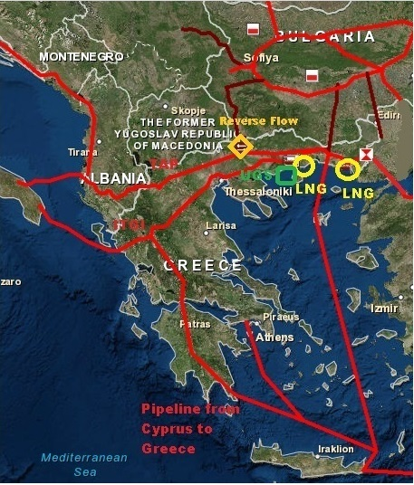
The EU gas target model
PCI Projects around Greece
TAP (10-20 bcma)
IGB ( 3-5 bcma)
IGI (10 bcma)
LNG Alexandroupolis (5-6 bcma)
EastMed (8 bcma)
UGS Kavala (WGV 360 MCM)
CS Kipi

